Slide 1
METAS PLOITABLE 2
Metasploitable 2 is a purpose-built, intentionally vulnerable Linux-based virtual machine (VM) developed by Rapid7, designed to serve as a target environment for penetration testing, vulnerability assessment, and exploit development. It emulates a legacy server environment riddled with outdated and misconfigured services to provide a comprehensive, real-world lab setup for ethical hacking and cybersecurity training.

Slide 2
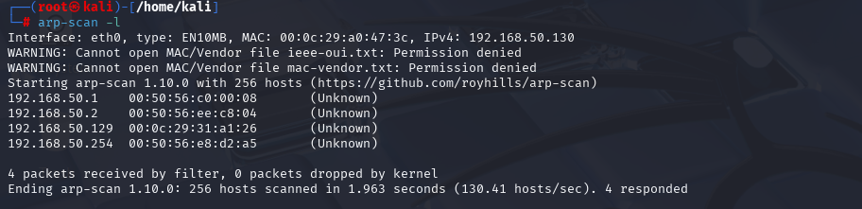
SEARCH METASPLOITABLE ID ADDRESS:-

Slide 3
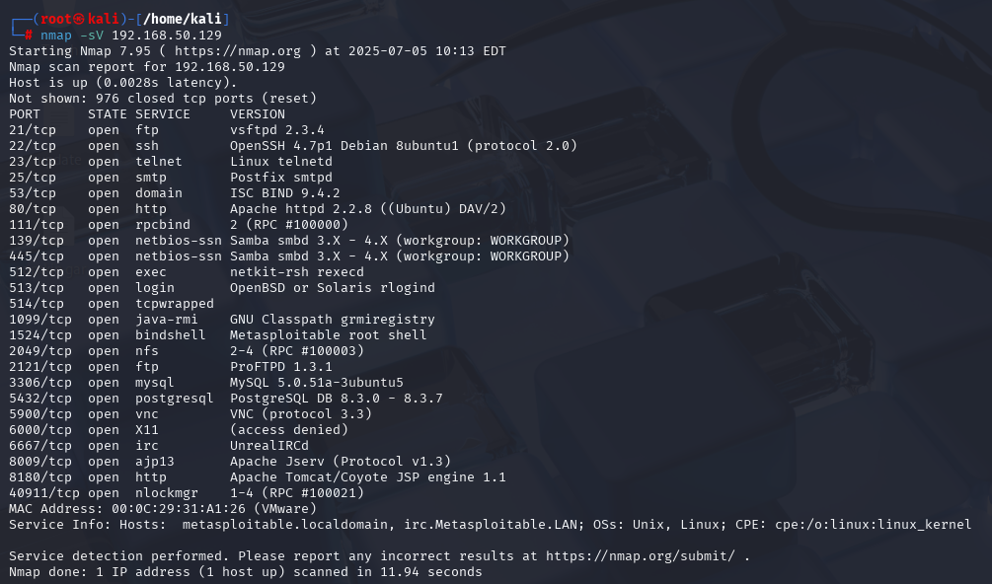
NETWORK SCAN:-

Slide 4
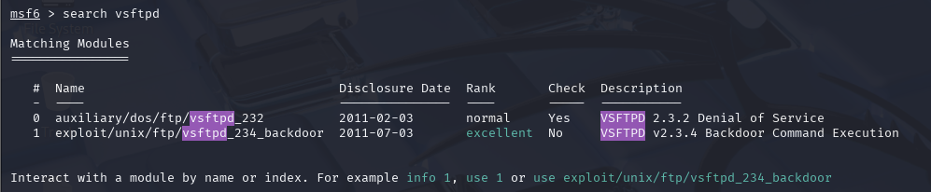
21-FTP EXPLOIT:-

Slide 5
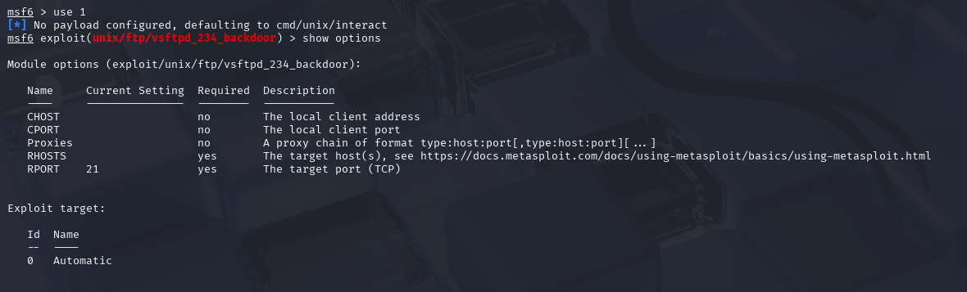

Slide 6
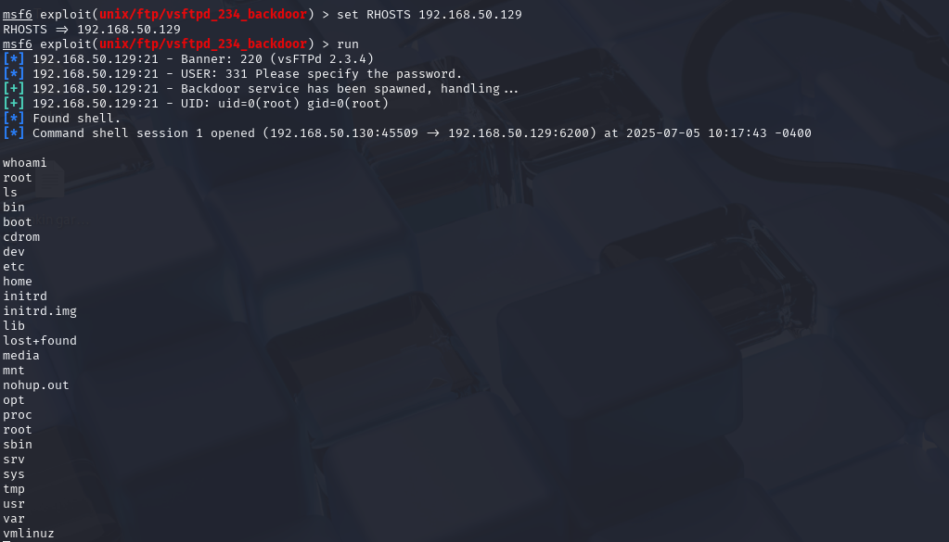

Slide 7
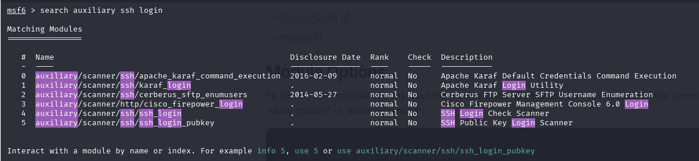
22 SSH PORT EXPLOIT

Slide 8
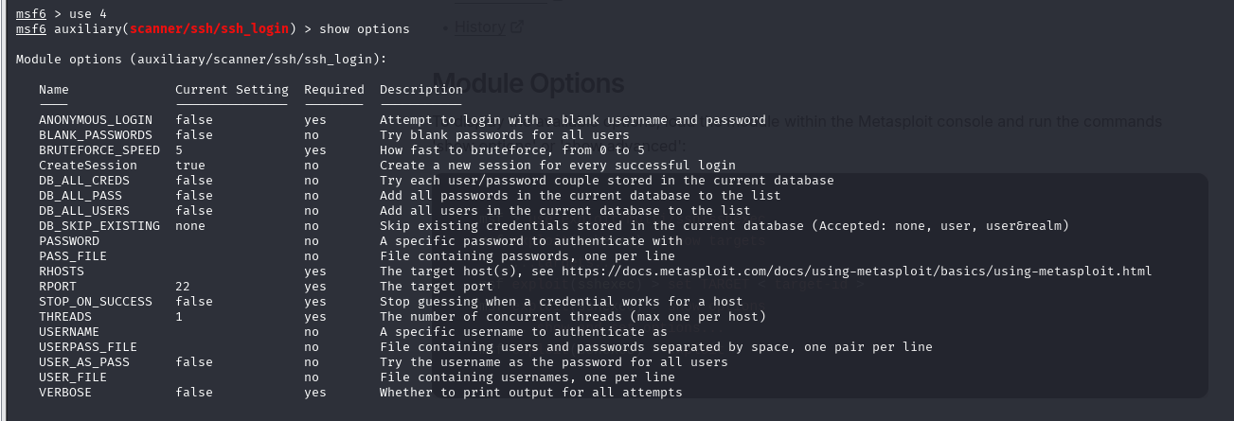

Slide 9
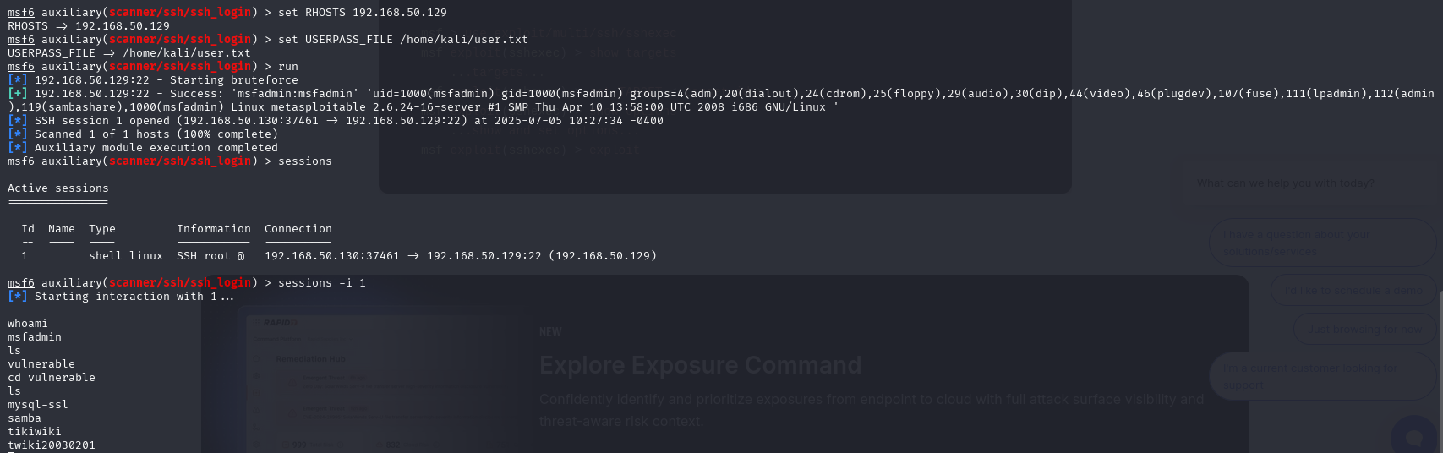

Slide 10
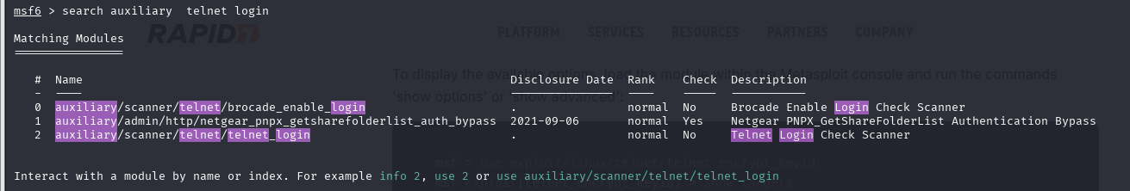
23 PORT TELNET EXPLOIT

Slide 11
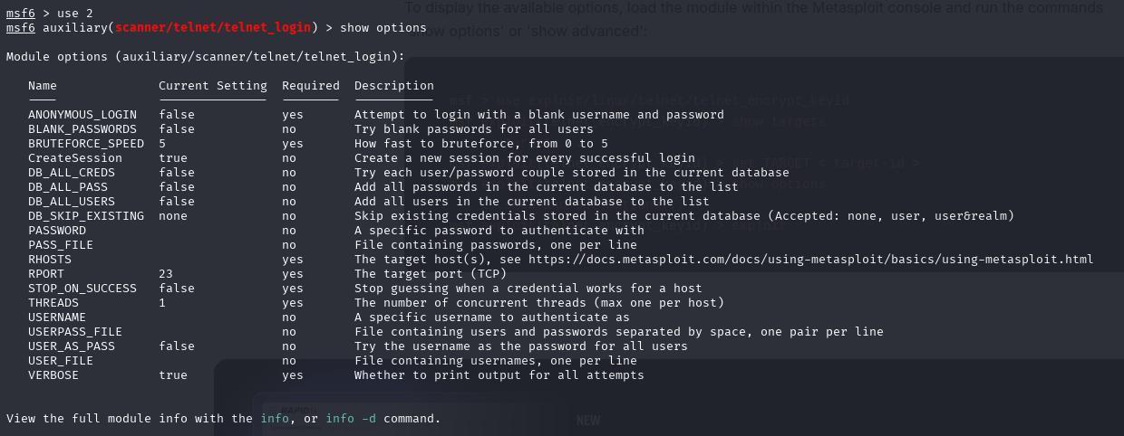

Slide 12
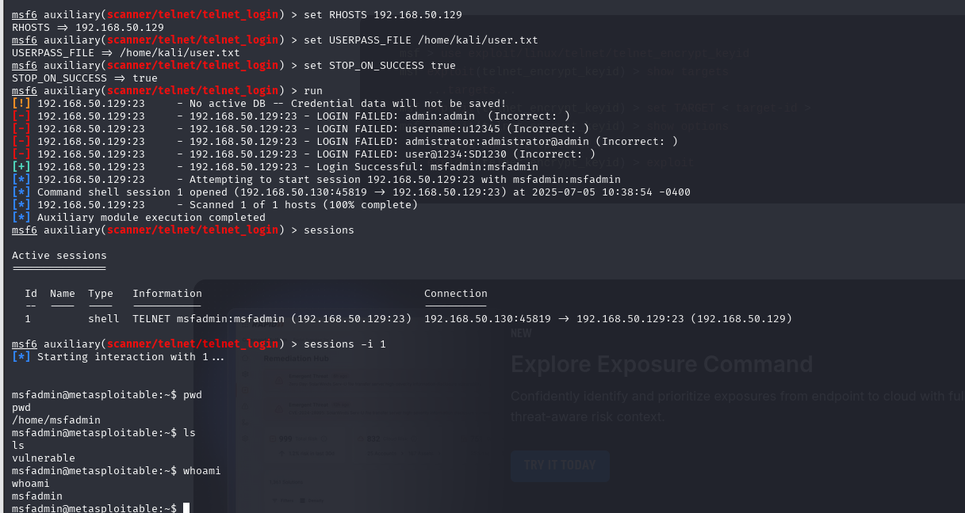

Slide 13
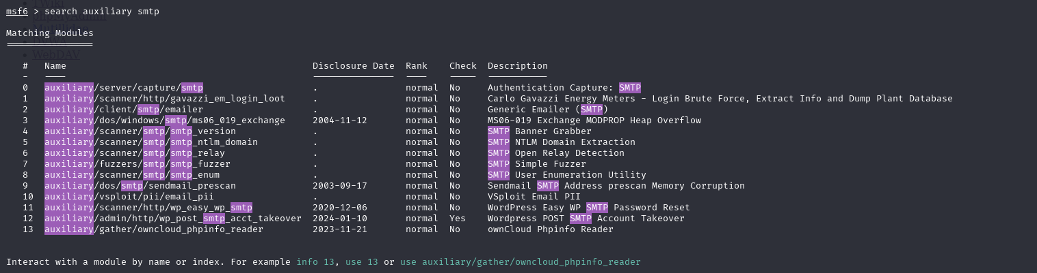
25 SMTP EXPLOIT

Slide 14
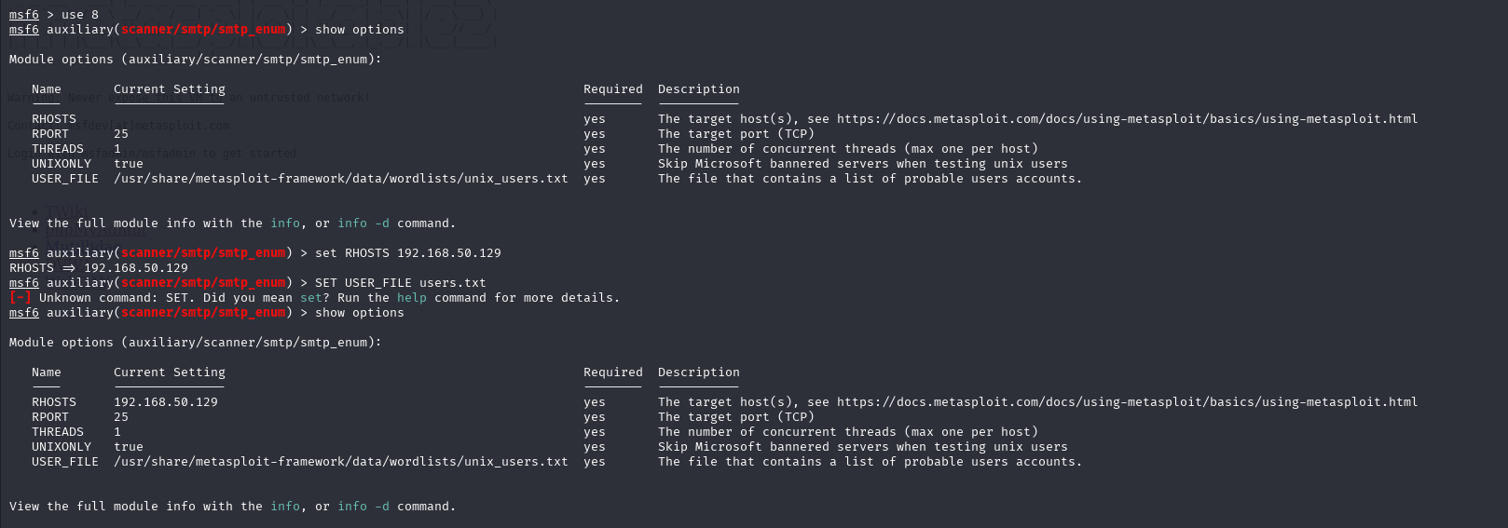

Slide 15
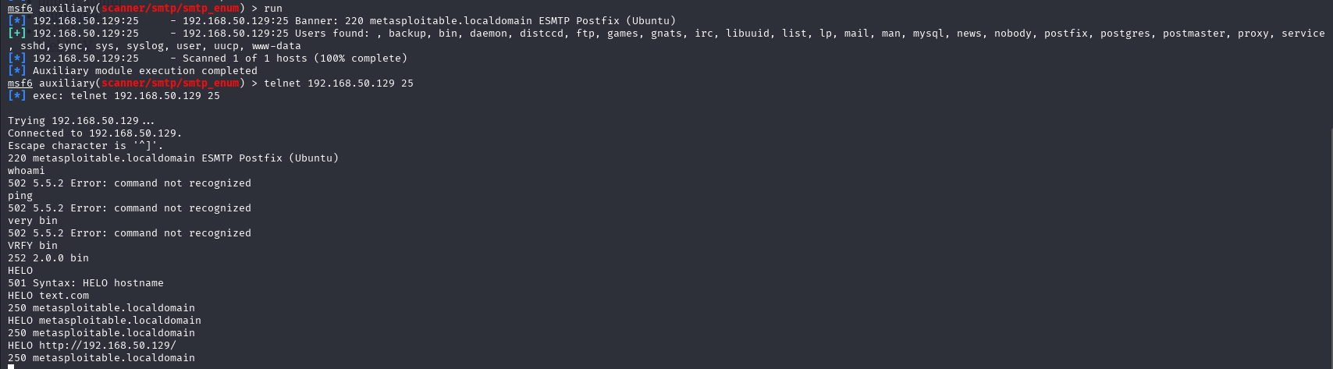

Slide 16
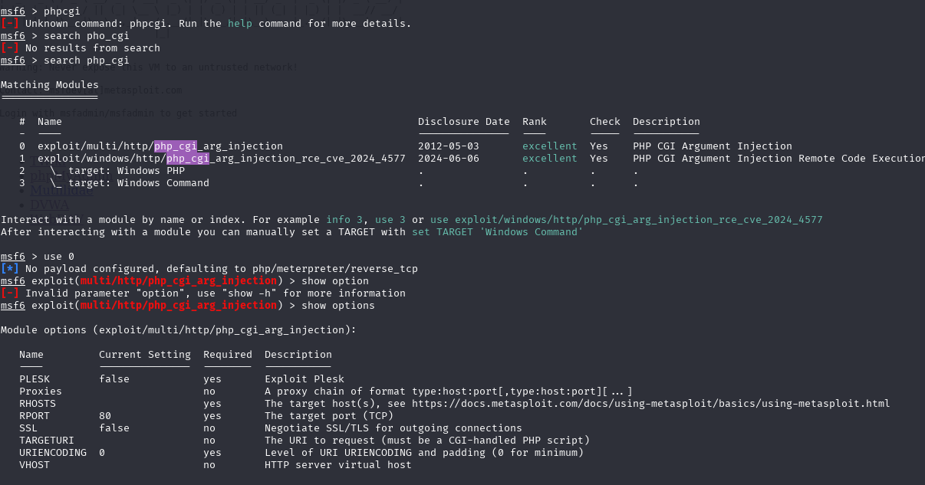
80 HTTP EXPLOIT

Slide 17
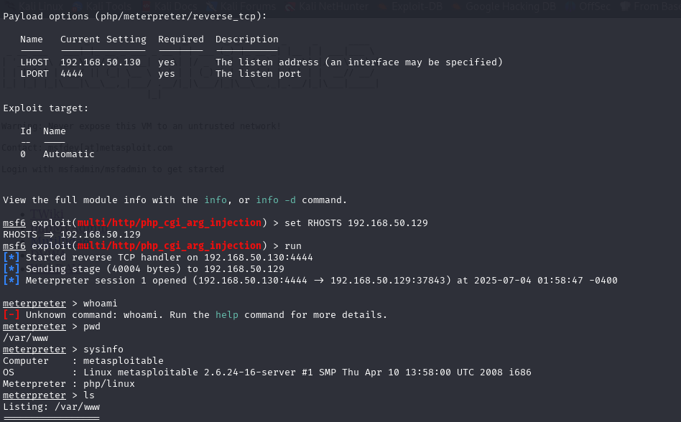

Slide 18
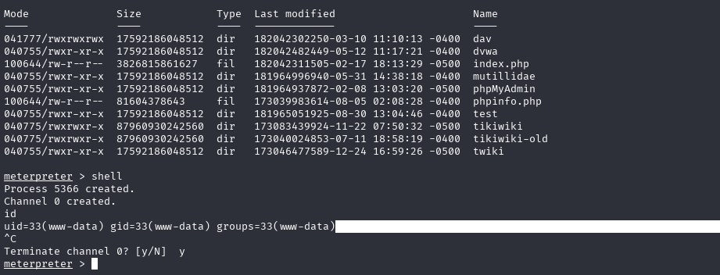

Slide 19
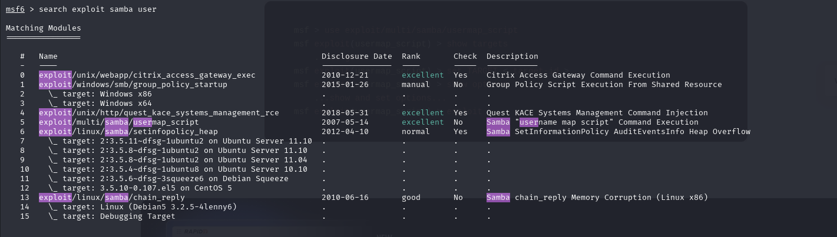
139 NETBIOS-SSN EXPLOIT

Slide 20
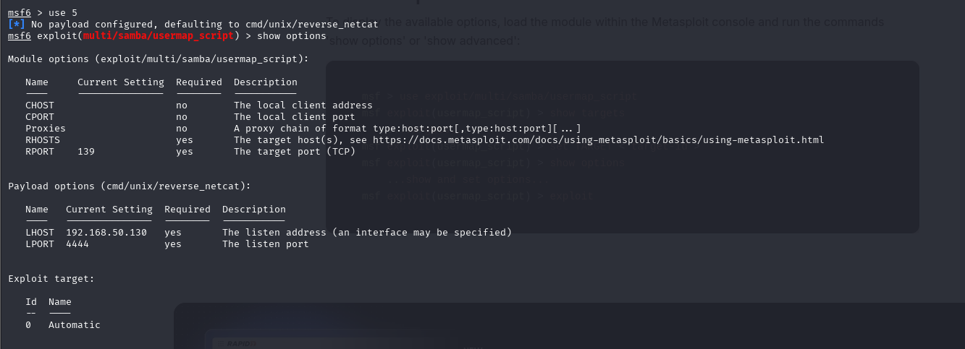

Slide 21
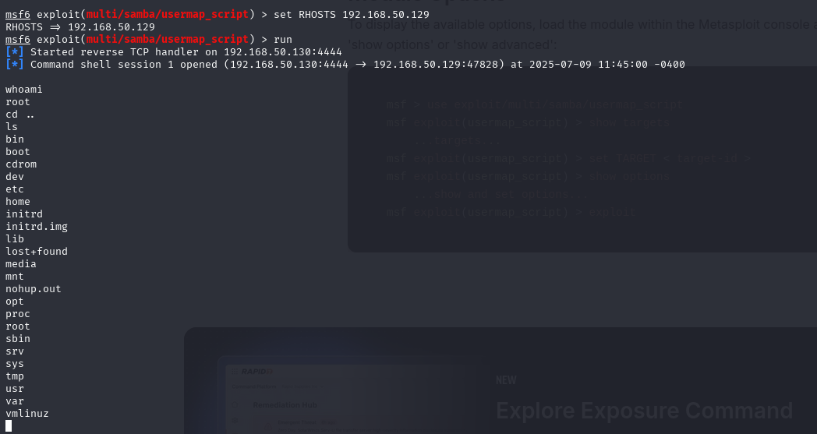

Slide 22
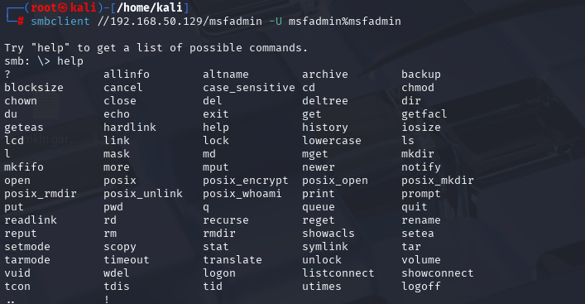
445:- samba

Slide 23
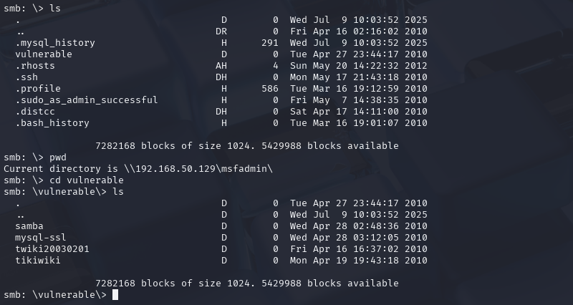

Slide 24
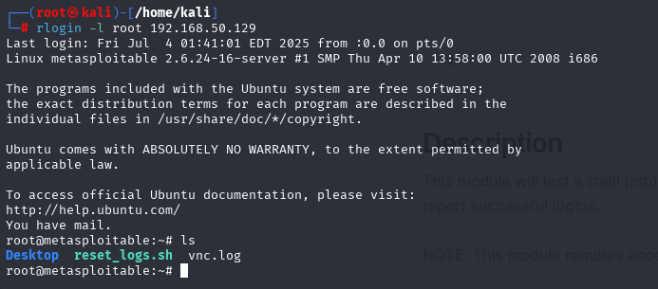
512 EXEC EXPLOIT

Slide 25
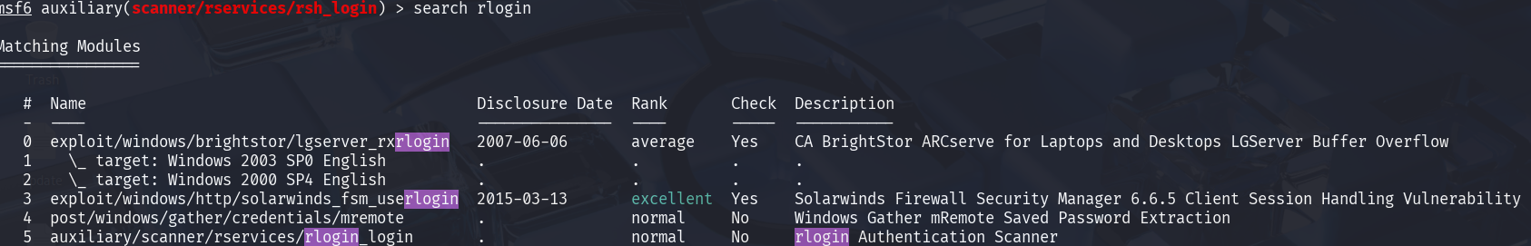
513 LOGIN EXPLOIT

Slide 26
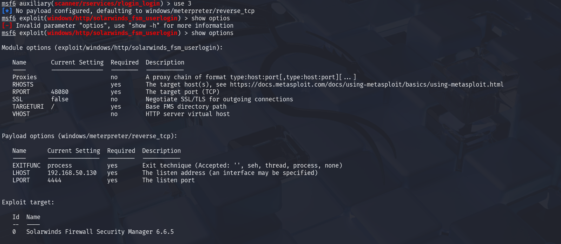

Slide 27
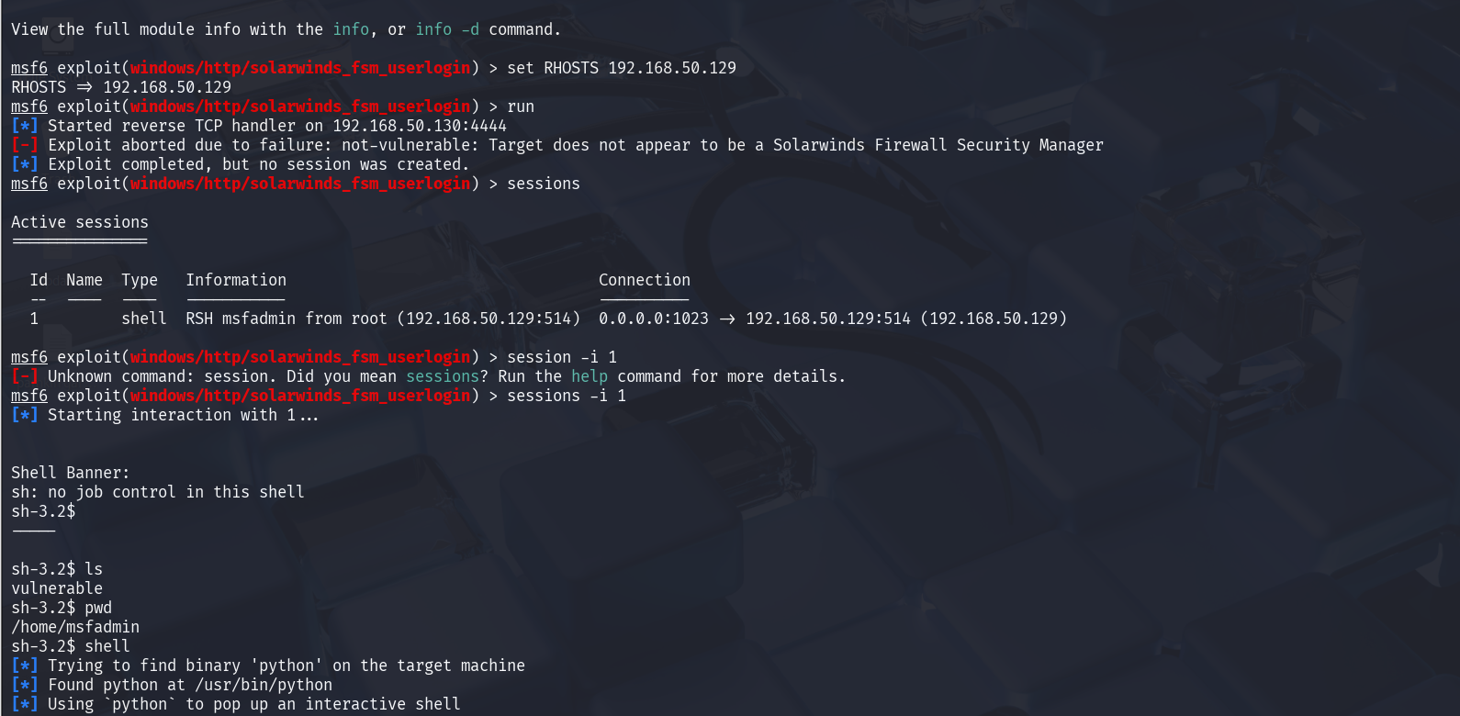

Slide 28
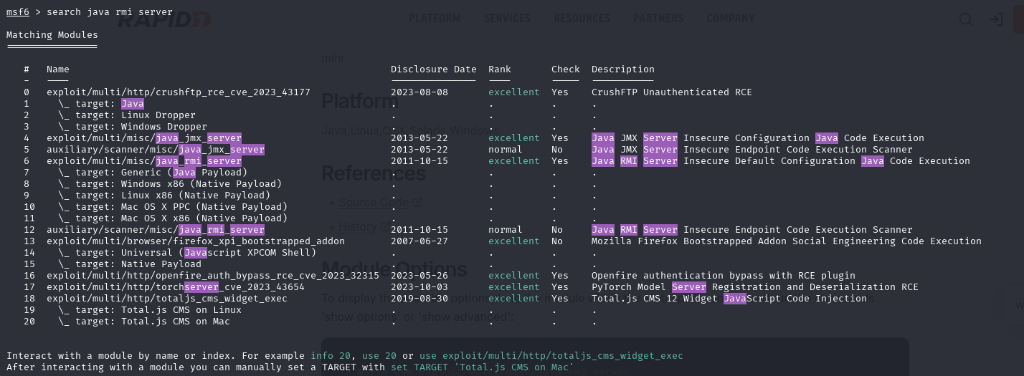
1099 JAVARMI EXPLOIT

Slide 29
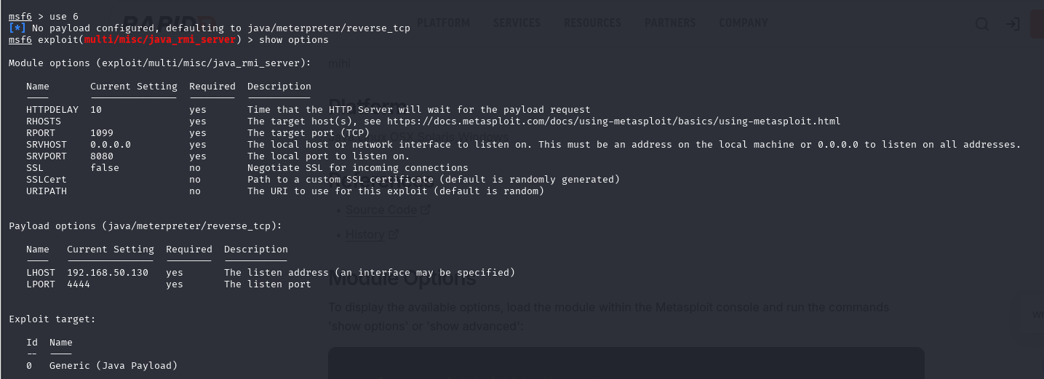

Slide 30
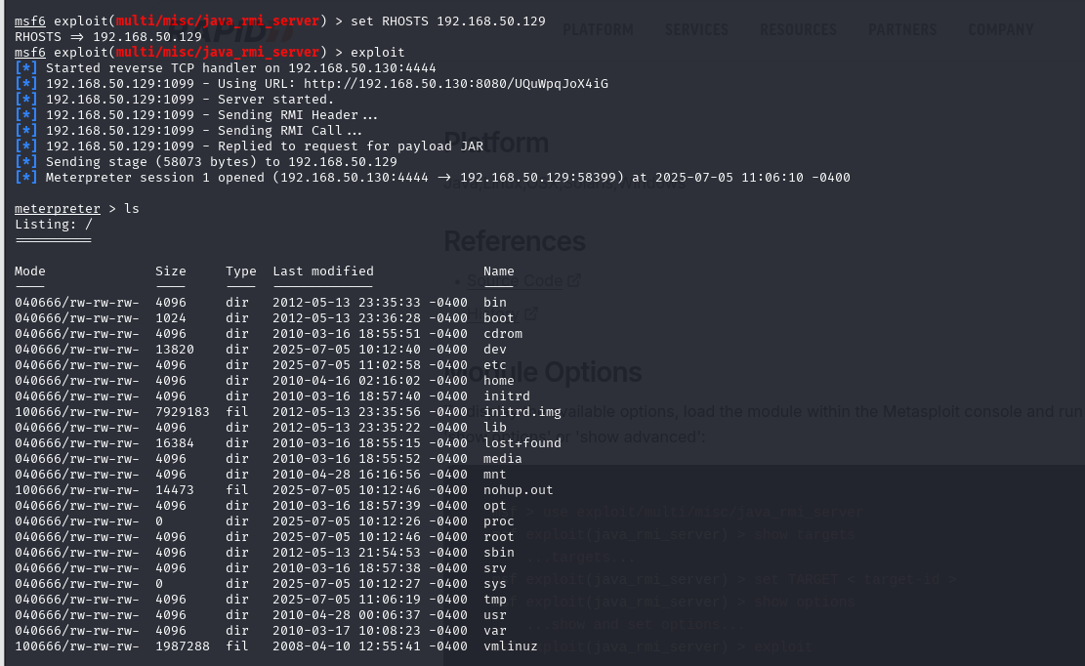

Slide 31
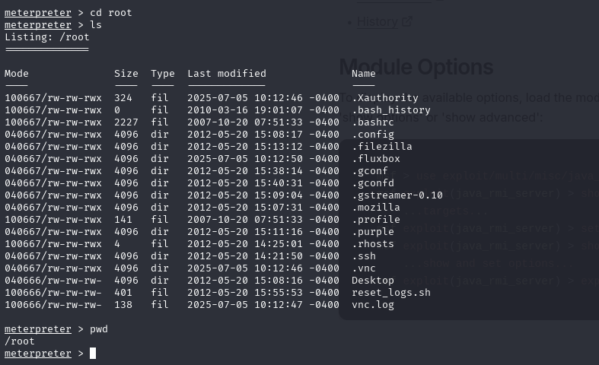

Slide 32
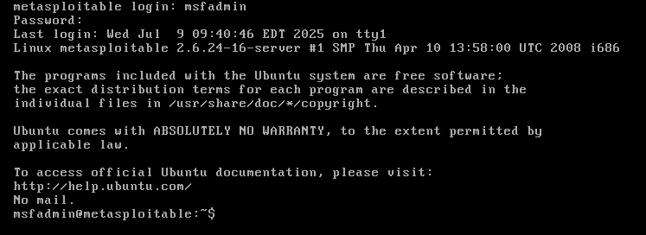
3306 MYSQL EXPLOIT

Slide 33
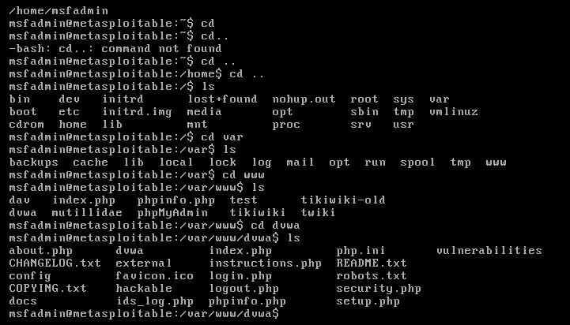

Slide 34
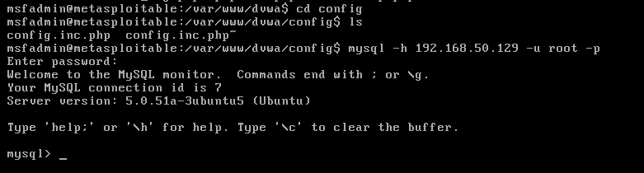

Slide 35
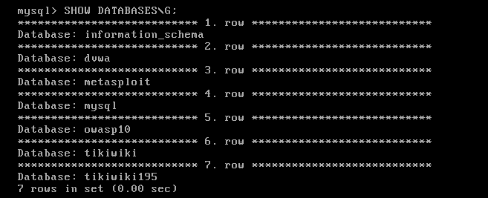

Slide 36


Slide 37
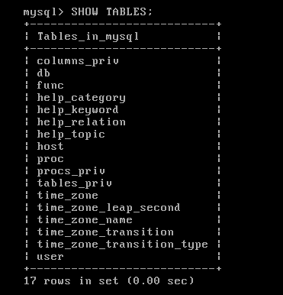

Slide 38
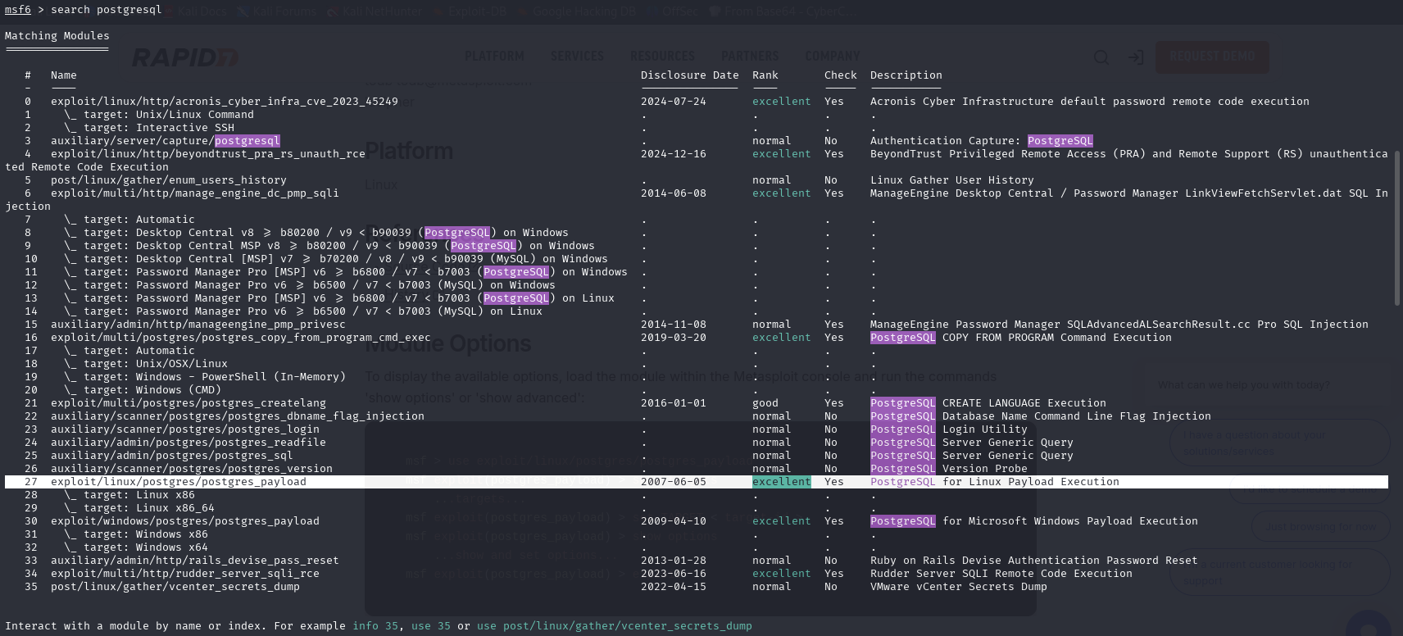
5432 POSTGRESQL EXPLOIT

Slide 39
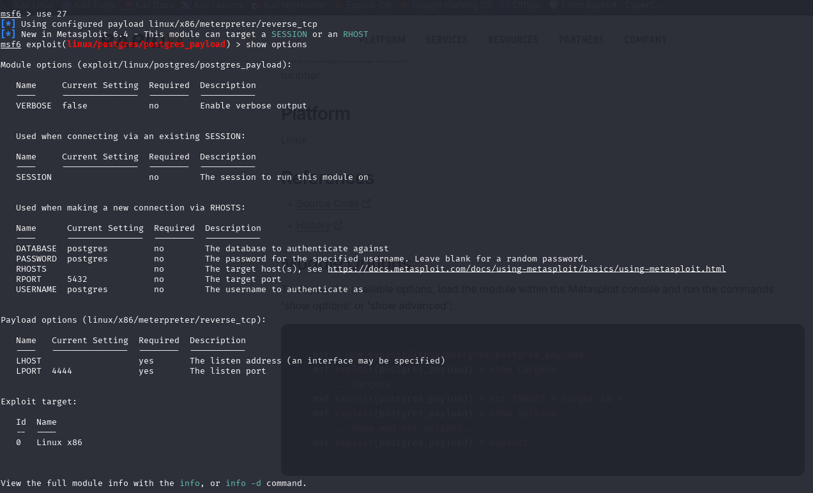

Slide 40
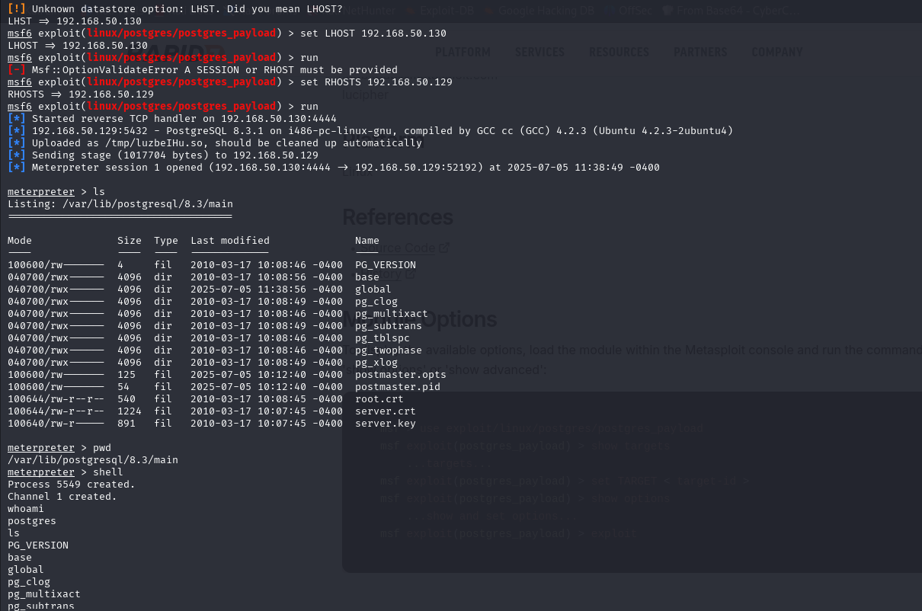

Slide 41
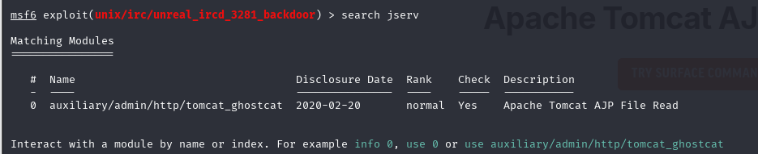
8009 AJP 13 EXPLOIT

Slide 42
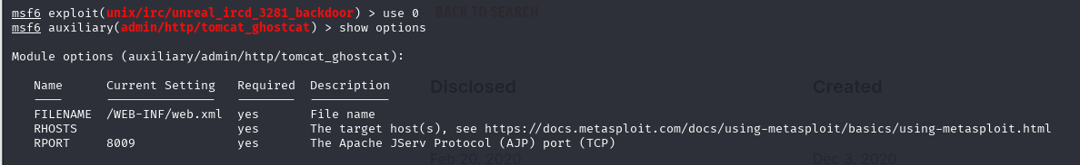

Slide 43
